Slide 1
Environmental Justice Poetics
Dr. U. Sumathy,
Associate Professor of English,
Government Arts College (Autonomous),
Coimbatore.

Slide 2
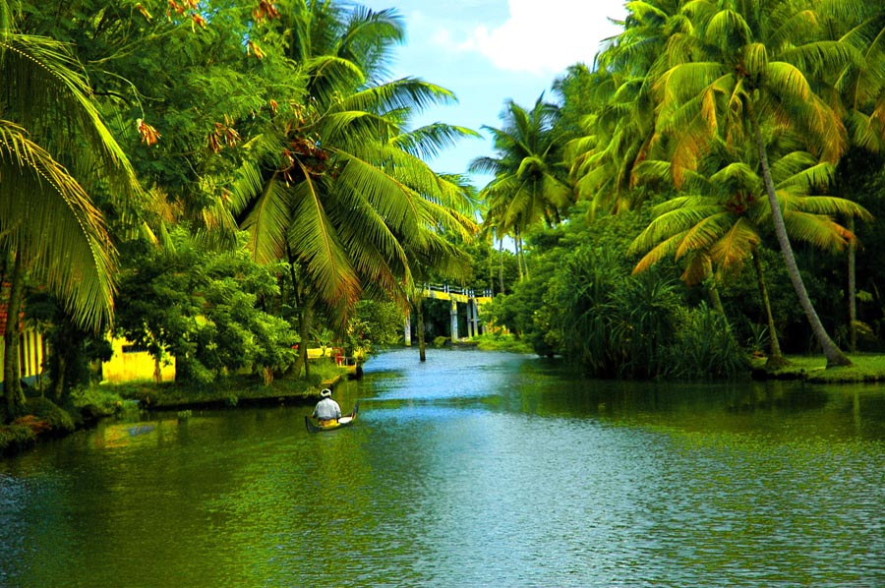

Slide 3
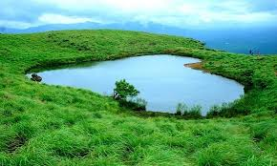

Slide 4
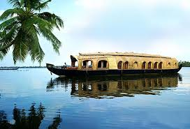

Slide 5
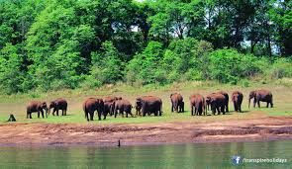

Slide 6
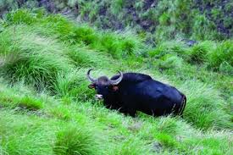

Slide 7
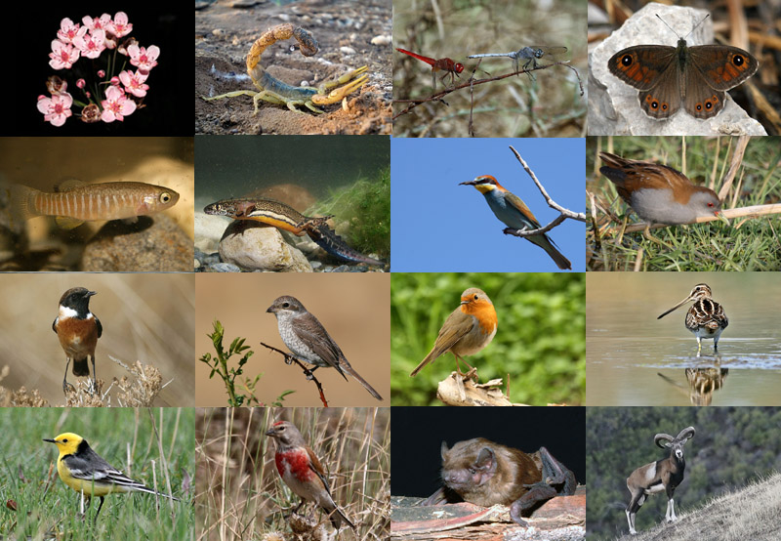

Slide 8
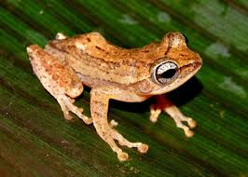

Slide 9
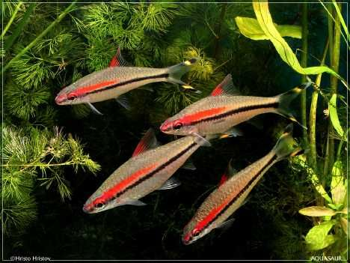

Slide 10
The world that was handed down to us was filled with limitless beauty, elixirine water, fertile soil and life giving air. Now man has turned it into a toxic spewing hell.

Slide 12
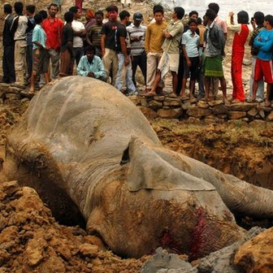

Slide 13
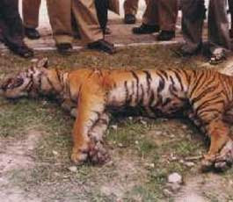

Slide 14
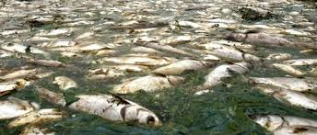

Slide 15
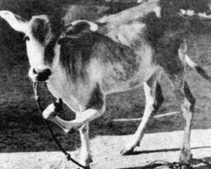

Slide 16
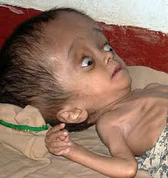

Slide 17
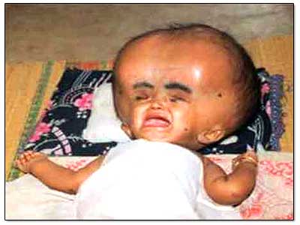

Slide 18
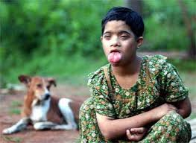

Slide 19
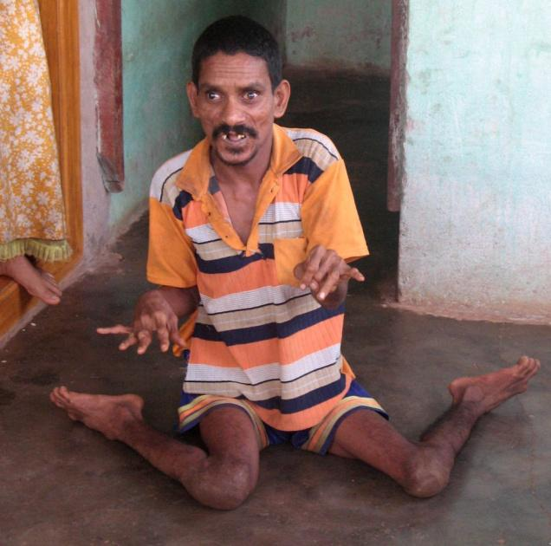

Slide 20
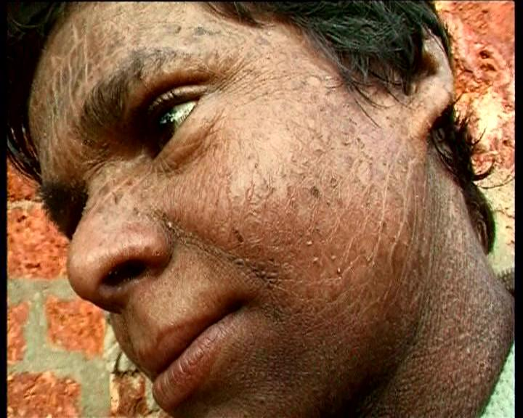

Slide 22
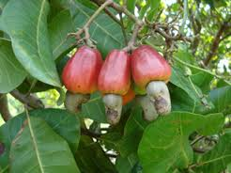

Slide 23
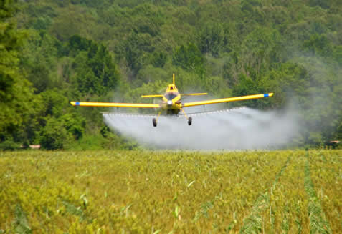

Slide 24
The Text
Ambigasudan Mangad’s Enmahaje. Trans. Sirpi Balasubramaniam. Kavitha: Pollachi, 2009.
A war between capitalism and humanity
A war between greed and sustenance
A war that will turn the entire earth a graveyard
Enmahaje documents the above fear
A book that shocks the conscience
Induces just anger in the reader

Slide 25
The Place
Enmahaje located in Kasarkod dist., North Kerala
A place of hills and rivers “Nature at its indulgent best”
The nature of the rivers in Enmahaje
1000s of waterholes
Sorgam: Gold yielding land
Peacocks, parrots and vultures (that could carry dogs)
Snakes and tigers worshipped
Snake shrines and conservation
Eight different languages and eight customs
The Jains and their customs
The Present?

Slide 26
The Present : Flora
Invaluable forests teeming with biodiversity destroyed
Monocrop culture: a terror unleashed by govt.
In Karnataka-Eucalyptus, Himalayas-Pine, Kerala-Acacia
Why in the name of afforestation, this foreign species?
In the land of jack fruit and mango, why this killer tree?
Yield reduced. Plants no longer healthy. Many rot fast.

Slide 27
The Present: Fauna
No fish, snake, frog, peacock
Not a drop of honey in the forests
The last monkey Sugreevan
Neelakandan’s fear: Two occasions: “What if there is no earthworm too?”
Crab, “What have you done to all the creatures that faced bravely the struggle for survival on this earth?”
Cattle with three legs

Slide 28
A Biodiversity Disaster
Study by Dr. V. S. Vijayan of Salim Ali Foundation
Enmahaje Panchayat’s biodiversity: Nilgiri langur, tiger, jackal, wild boar, jungle cat, mouse deer, mongoose, squirrels, flying fox, black naped hare, sparrow, parakees, crows, frogs, honey bees, snails
Everything except human beings disappeared during the spray
Dead carcasses in plantations
Fish : Worst affected
Absence of crows and the aftermath

Slide 29
The Present : Humans
Parikshit: 7, Body with blisters, greying hair, can make only croaking sounds
Bagyalakshmi: 13, tongue lolling out
Anwar: 26, fingers and toes like tentacles
Abilash: resembles a monkey in appearance and gestures
Anju: urinary bladder hangs out
Sujith: 8, with brittle bones
Haritha: advancing mental derangement ending in suicide
Mamta: Haritha’s sister also afflicted
Mentally retarded children chained to posts
Scores of patients at the medical camp

Slide 30
The Cause
Aerial spraying of Endosulphan in 5000 hectares in Kasarkod
For 23 years from 1978 to 2001
To protect crop from tea mosquito
The toxic rain sprayed on the hills ran down to mix with streams, rivers throwing open the doors of hell.
Organo chlorine remains in the soil
Physical and mental disorders
Known cases of death all over the world
Breast milk: 22.4ppm, blood: 196.4ppm
900 times above permissible limit
Butter has endosulphate
How much ppm endosulphan in this jack fruit?
Modified DNA and the recurring consequences for 50 yrs.

Slide 31
The Comparison
We have heard of Nuclear Holocaust in Hiroshima. A similar bomb is blasted here. The effect percolates little by little.

Slide 32
The Irony
When there are no living creatures, how will the tea mosquito alone survive?
In order to kill the non-existent pest, poison worth crores of rupees is dumped in this region

Slide 33
The Law
Precautionary measures:
Protective gear, covering water bodies, mornings, announcements to be made, doctors to be sensitized.
Same insecticide not to be used for more than three years.
None of the above criteria followed
Bans in US, Bangladesh and Britain

Slide 34
The Locals’ Interpretation
Firm belief: Jadathari’s anger and curse. None can escape
Man-made disasters as fate
Damodar Shetty on Haritha’s death: Voodoo and witchcraft
Poor, innocent, uneducated and marginalized
25 yrs. to realize the real curse is the poison
Benign and peace-loving like cows
Unlike urban dwellers who invite diseases with degraded lifestyles who can also find cures
Saradha doesn’t have money to buy rice. How can she afford five surgeries to cure her daughter?
Why are these children wronged? The parents who wait for God’s grace did not err in any way

Slide 35
What is Environmental Justice (EJ)?
Lawrence Buell, “EJ is community based resistance against toxification of local environment. It broadens the scope of environmentalism to include the basic needs of poor and politically less powerful groups.”
Dorceta E. Taylor, “EJ integrates both social and ecological concerns”
Oppression and social exploitation is inseparable from rape and exploitation of natural environment. Health of one depends on the other.
EJ Paradigm: The right of all individuals to be protected from environmental degradation.
EJ aims to redress the disproportionate incidence of environmental contamination in communities of the poor.

Slide 36
Environmental Racism
Racial discrimination in environmental policy making and the enforcement of regulations and laws, the deliberate targeting of people of colour communities for toxic waste facilities, the official sanctioning of the life threatening presence of poisons and pollutants and the history of excluding people of colour form the environmental movement.
“We all live on the same planet but we don’t breathe in the same air. Some environments are more equal than others”
Communities living in sacrifice zones
Risk burdens localized but benefits generalized
Disparities created, tolerated and institutionalized by local, state and government action

Slide 37
Dimensions of EJ
Converting rivers into ditches and uninhibited sand mining
Cultivation lands converted to residential plots
Uncontrolled pollution from industries
Building of dams in tribal lands
Their habitats sold to industrialists for their mineral wealth

Slide 38
EJ Movements in India
Bhopal Gas Tragedy: Methyl Isocyanate Poisoning
Deaths : 3,000- 8000; 8000 later deaths
The Continuing Struggle for justice
The Ticking Bomb: GAIL’s 3,000 cr. Pipeline project through the agricultural fields of Coimbatore, Erode, Salem, Krishnagiri to Bangalore.
More than 1,20,000 fruit bearing trees would have to be uprooted for laying the pipes
Demand: change the alignment of pipeline
Collectors directed to firmly enforce law.

Slide 39
Environmental Justice Criticism
Ecocriticism puts human figures at the margin
EJ Criticism : T.V. Reed: “To foster new work that understands and elaborates the crucial connection between environmental concerns and social justice in the context of ecocriticism”
What can EJ Criticism Do?
Focus on texts that show how environmental degradation and hazards affect the poor.
How has the class divide lead to greater environmental irresponsibility.
How can worker safety and environmental safety be brought together?
Foregrounding texts written by the coloured and the Third World writers
EJ criticism adds a new dimension to ecocriticism

Slide 40
Enmahaje as an EJ Text
Novel a refraction of historical actualities
The poor and the innocent targeted
The officials do not drink water or tender coconut from Enmahaje
Records accurately the problem, the affected communities and their struggle for justice
Double victimization of Muthalamada endosulfan victims
188 living victims; 77 chronically ill
“As poor Dalit and tribal coolie workers, we remain unorganized. Struggling even to get a decent pay for the hard work in farm lands, we are incapable of organising a Kasarkod model struggle”, Chandran to The Hindu
The deadly manual spray
NHRC sought an exclusive report

Slide 41
Silent Spring and Enmahaje
A resonance of Rachel Carson’s Silent Spring (1962)
Documented the detrimental effects of DDT on the environment.
The ban in 1972
Neelakandan’s mantra piecered the silence of nature: “Nisaptham poonda iyarkaiyai nookip painthu paraviyathu”

Slide 42
The Struggle
Neelakandan, the embittered social activist and his partner Devi
Jayarajan, the environmental enthusiast, who pays with his life
Dr. Arunkumar, who sacrifices bright career to serve the poor
Sriramar, freelance journalist, farmer
Prakasa, first mentions the link between spray and death of bees
Leelakumari, the former official, left paralysed
Formation of Endosulphan Spray Protest Action Committee (ESPAC)
The initial victory
The schemes of the “leader” and the minister
The medical camp
Affected children as exhibits
Parikshit’s body taken as a procession
Jayarajan collects evidence but is murdered

Slide 43
The Apathy
The interpretation for insecticide
Endosulphan sprayed in govt. owned plantations by govt. What can anyone do about it?
Enquiry commissions submit reports without visiting affected areas
Twist tales and give clean chit to Endosulphan
Lab reports meddled with
Deformities attributed to consanguineous marriages
Activists threatened arrested on false charges and tortured
Jayarajan brutally murdered

Slide 44
The Ban and the Continuing Struggle
Endosulphan banned in 2001
Same composition in other pesticides
Marketed with 50 names in India
The cruel connotation of the brand names: ‘Round Up’, ‘Machete’, ‘Pentagon’, ‘Prowl’ ‘Revenge’
Our struggle is not only against Endosulphan. It is against all the chemical pesticides that turn this planet into a desert

Slide 45
Facts about the Struggle
Only in Mid 1990s people saw the connection
Media visibility
Numerous marches and protests
Medha Pathkar and Arundhati Roy
Slogan, “Endosulfan Quit India”
The Hindu 3rd Feb. 2016: Another round of talks with CM. Laxity in implementing the National Human Rights Commission recommendations. Apathy of banks
Endosulfan Virudha Samyukta Samara Samithy : deteriorating health of victims as they brave the scorching heat.

Slide 46
Enmahaje as Faction
The Fantasy elements
The surrealist moments
The cultural constructs
The cave as Noah’s Arc
When the poisonous apocalyptic rain strikes Enmahaje, all the remaining living creatures will take refuge and live in the cave. Until the rain stops.
Text as a tool

Slide 47
The Solution
Pesticides and insecticides to be replaced by herbicides
Green Revolution and its environmental costs
Environmentalists need to hear both the cry of the earth and the cry of the poor
Responsibility to rehabilitate the victims
Preserve the richness and fertility of the soil for the coming generations.

Slide 48
The Future
Thasaputhro samovabi
Thasapapi samovirutha
Thasaviruthu samamatha
Thasamathaya samathadu
One pond is equal to ten sons
One lake is equal to ten ponds
One mother is equal to ten lakes
One tree is equal to ten mothers
So, one tree is equal to ten thousand sons

